Slide 1


Generative Design
Programming Environments for
Guilherme Ferreira
Instituto Superior Técnico

Slide 2
Problem
Survey
Solution
Conclusion

Slide 3
1
Problem

Slide 4
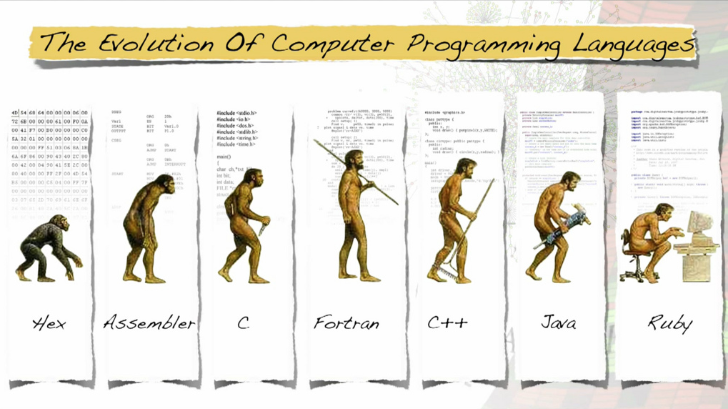
© 2015 by the ACM Magazine for Students

Slide 5
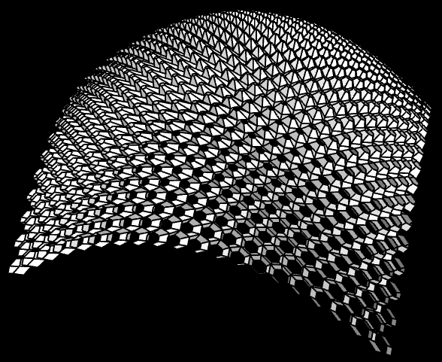
Generative Design Environments
(define (skin-open-srf srf panel panel-f panel-h att)
(sphere att 0.03)
(iterate-quads
(lambda (h0 h1 h2 h3)
(panel (list-ref h0 4)
(list-ref h0 3)
(list-ref h1 4)
(list-ref h2 1)
(list-ref h2 0)
(list-ref h3 1)
panel-f panel-h att))
(iterate-quads
(lambda (p0 p1 p2 p3)
(let* ((a (ptf p0 p3 0.17))
(b (ptf p0 p1 1/2))
(f (ptf p0 p3 1/2))
(j (ptf p3 p2 1/2))
(e (ptf b j 2/3))
(k p1)
(l p2)
(c (ptf k l 0.17))
(d (ptf k l 1/2))
(w (ptf k l 2/3))
(g (ptf (ptf p0 p3 2/3) (ptf p1 p2 2/3) 3/2))
(h (ptf p3 p2 3/2))
(i (ptf k l 1.17)))
(panel a b c d e f panel-f panel-h att)
(list a b c d e f)))
(transpose-matrix srf))))
(define (hex-panel-1 p0 p1 p2 p3 p4 p5 f h att)
...)
(define (hex-panel-2 p0 p1 p2 p3 p4 p5 f h att)
...)

Slide 6
What does “define” mean?
What do these words after “define” mean?
(define (skin-open-srf srf panel panel-f panel-h att)
(sphere att 0.03)
(...)
What about this number after “att”?
What unit is it? What range does it have?
Do these words all mean the same thing?
Why are there so many words?

Slide 7

How do we get people to understand programming?
© 2012 by Jenna Scaglione, webdesignerdepot

Slide 8
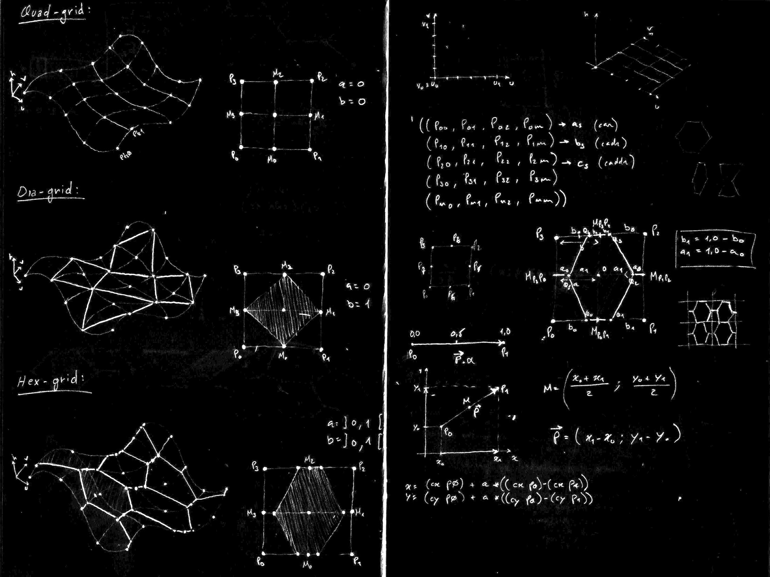
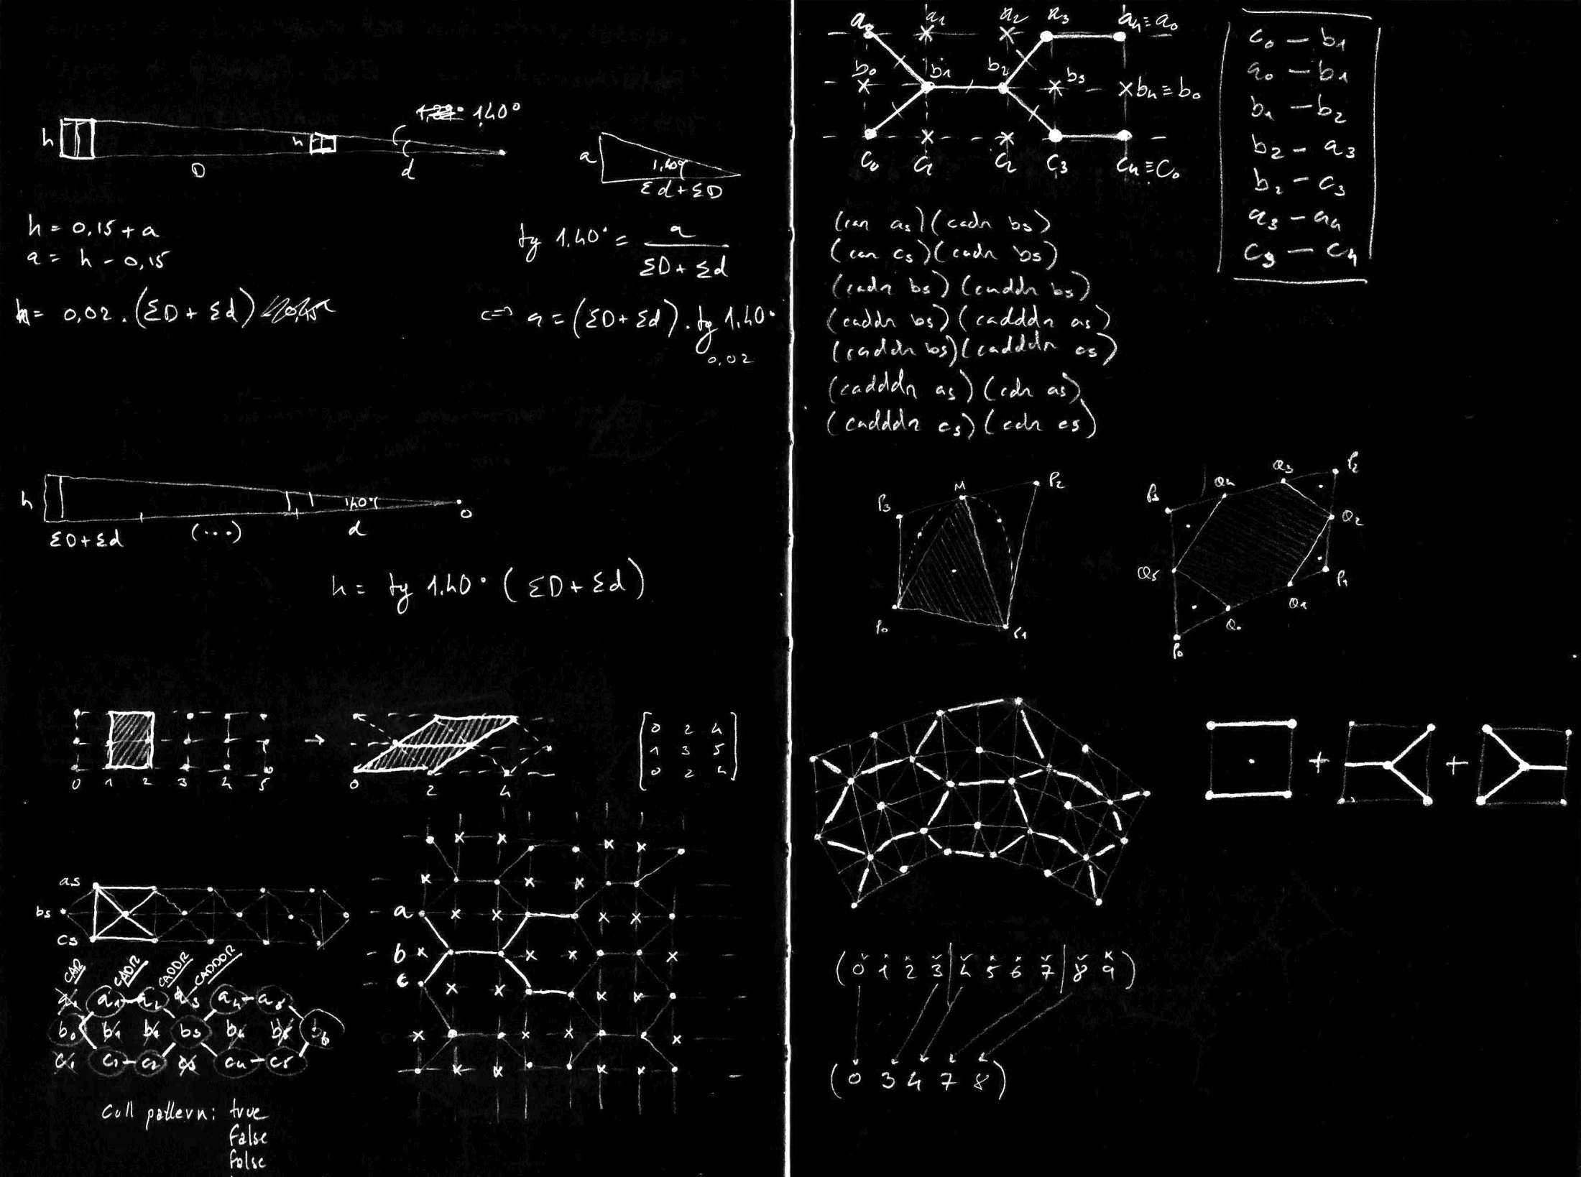
People understand what they can see

Slide 9
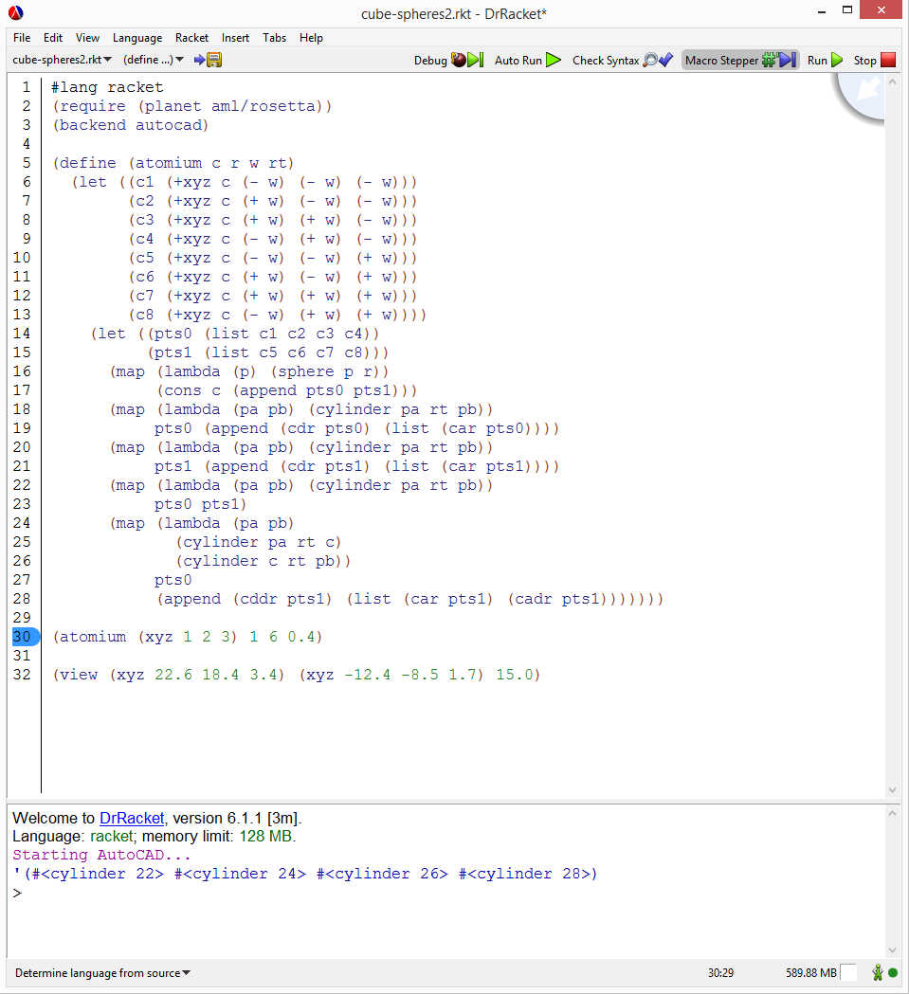
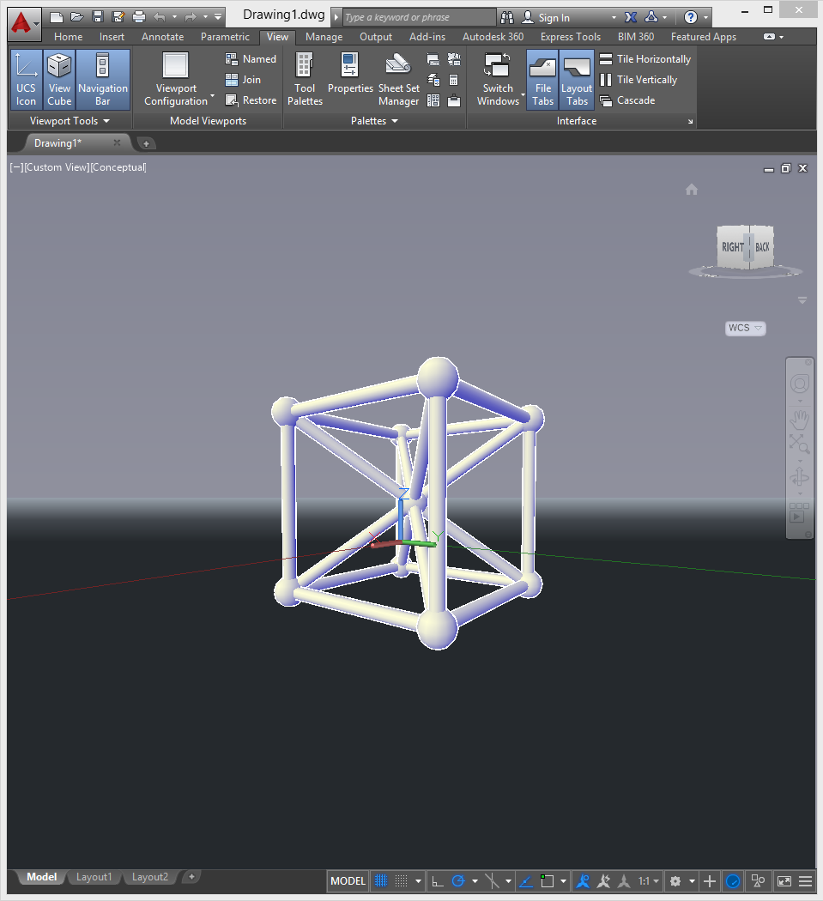
Creators need a medium connection

Slide 10
Creators need a medium connection

Slide 11
2
Survey

Slide 12
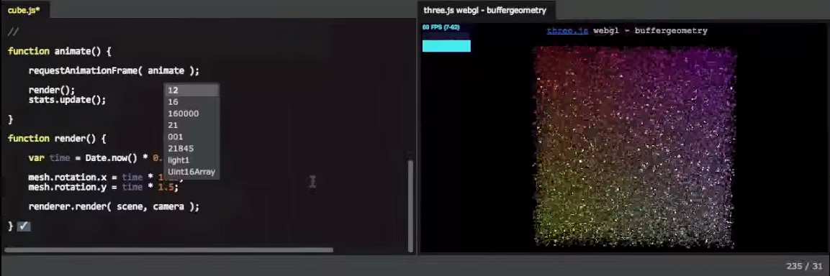
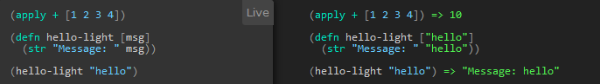
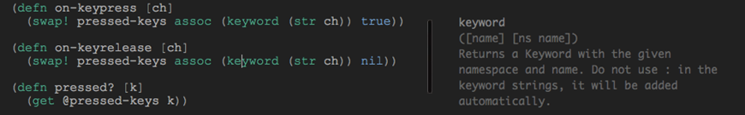
LightTable (Chris Granger, et al)

Slide 13
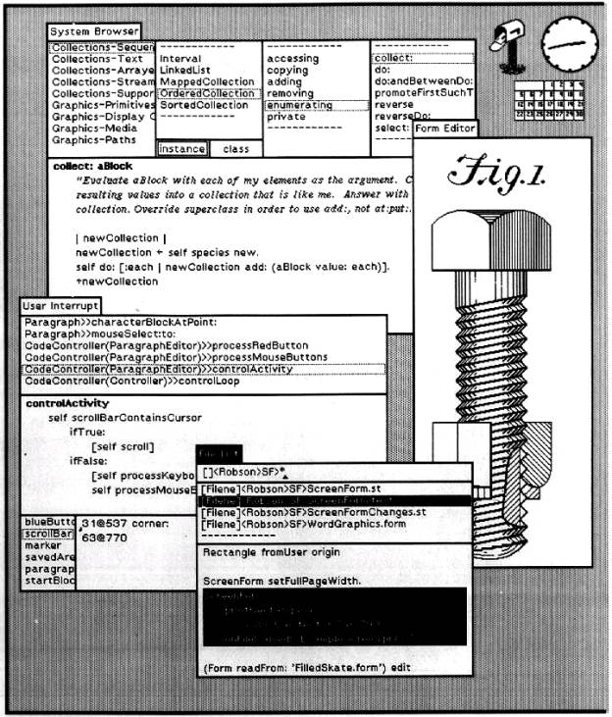
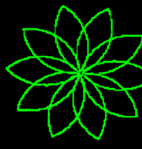
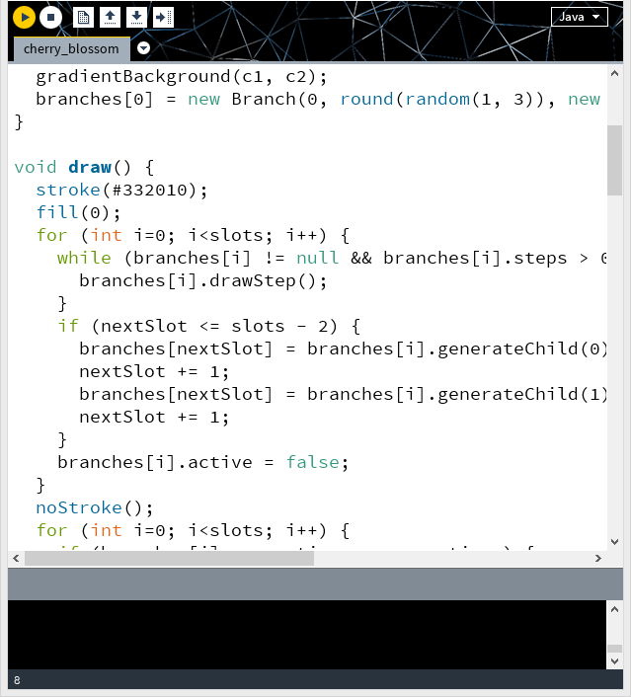
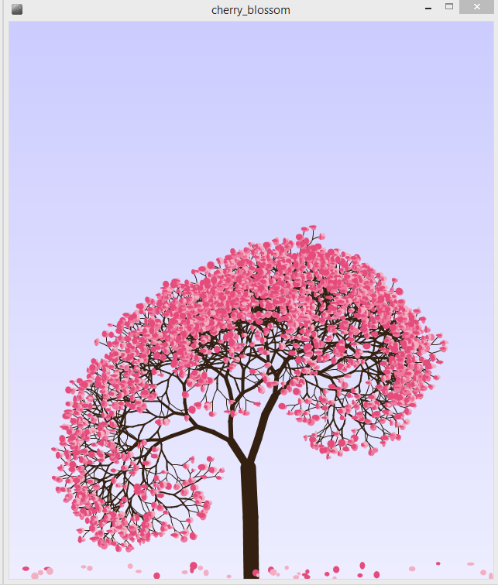
Logo (Seymour Paper, et al)
Smalltalk (Alan Kay, et al)
TO NEWFLOWER
REPEAT 10
PETAL
RIGHT 360/10
END
Processing (Casey Reas and Benjamin Fry, et al)

Slide 14
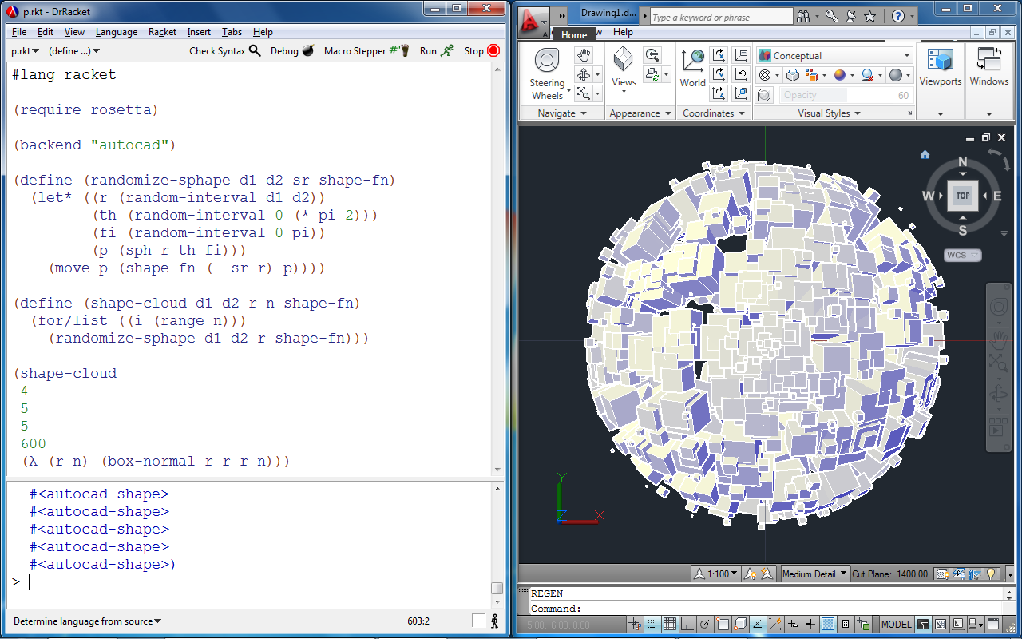
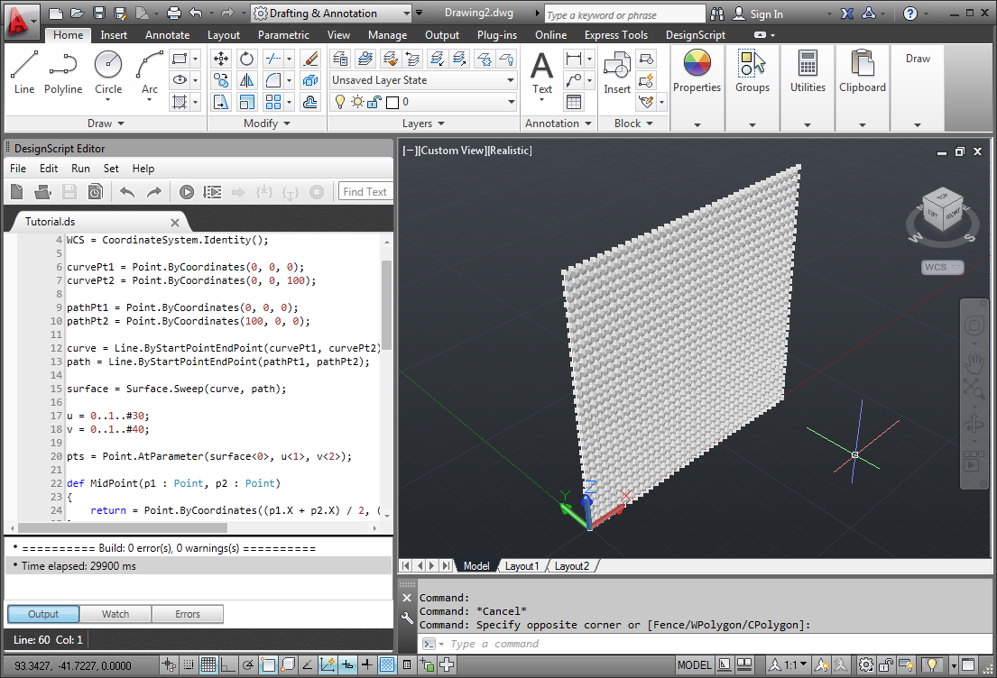
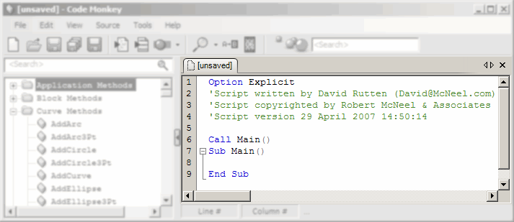
Rosetta (António Leitão, et al)
DesignScript (Robert Aish, et al)
Monkey (David Rutten , et al)

Slide 15
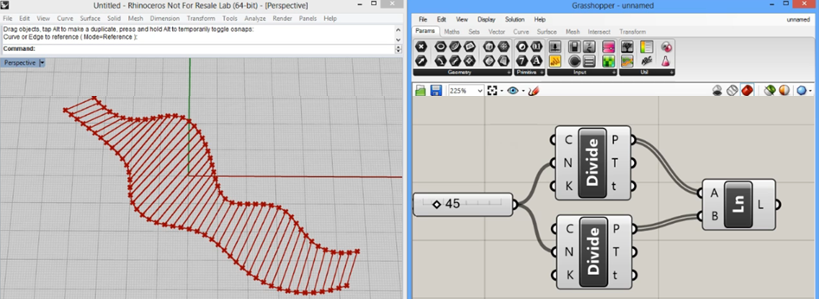
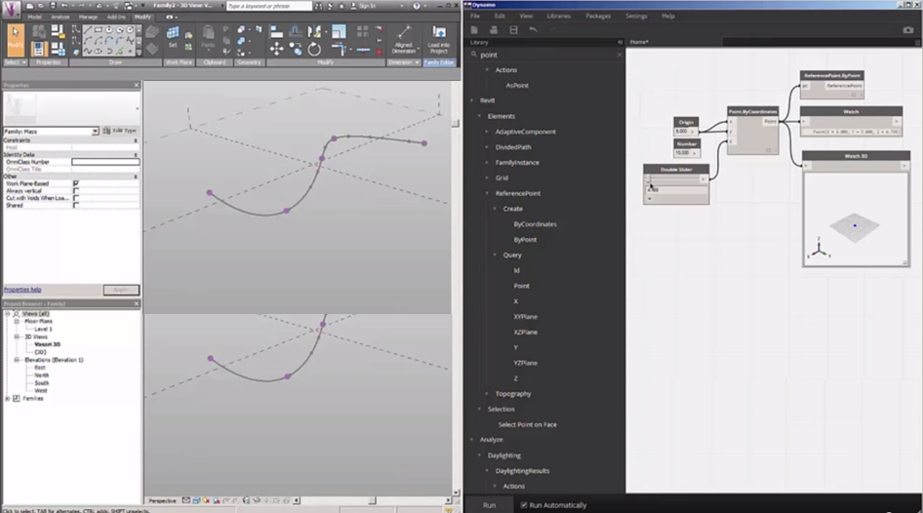
Grasshopper (David Rutten, et al)
Dynamo (AutoDesk)

Slide 16
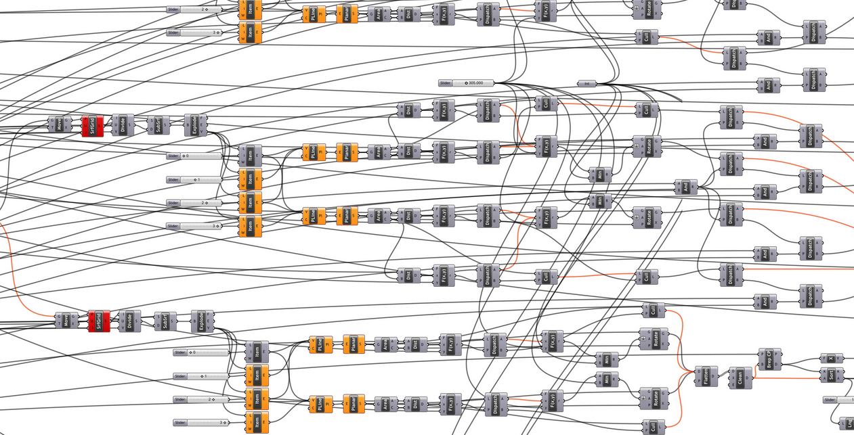
How can we understand this program?
© Aaron Tobey

Slide 17
3
Solution

Slide 18
People understand what they can see

Slide 19
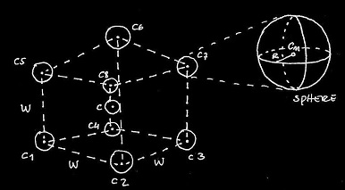
def cubeSpheres(c, r, w):
c1 = c+xyz(-w,-w,-w)
c2 = c+xyz(+w,-w,-w)
c3 = c+xyz(+w,+w,-w)
c4 = c+xyz(-w,+w,-w)
c5 = c+xyz(-w,-w,+w)
c6 = c+xyz(+w,-w,+w)
c7 = c+xyz(+w,+w,+w)
c8 = c+xyz(-w,+w,+w)
for p in [c1,c2,c3,c4,c5,c6,c7,c8]:
sphere(p, r)
Documentation
Program

Slide 20
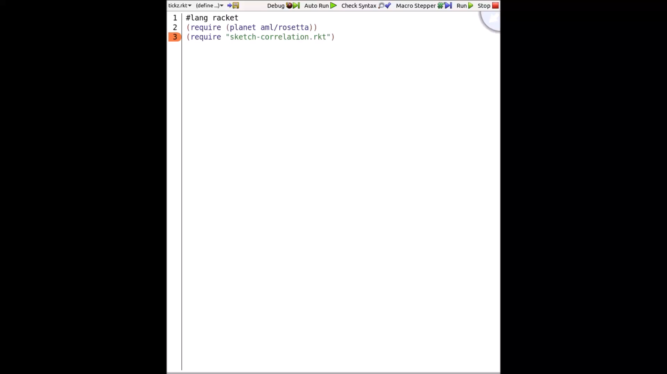

Slide 21
Creators need a medium connection

Slide 22
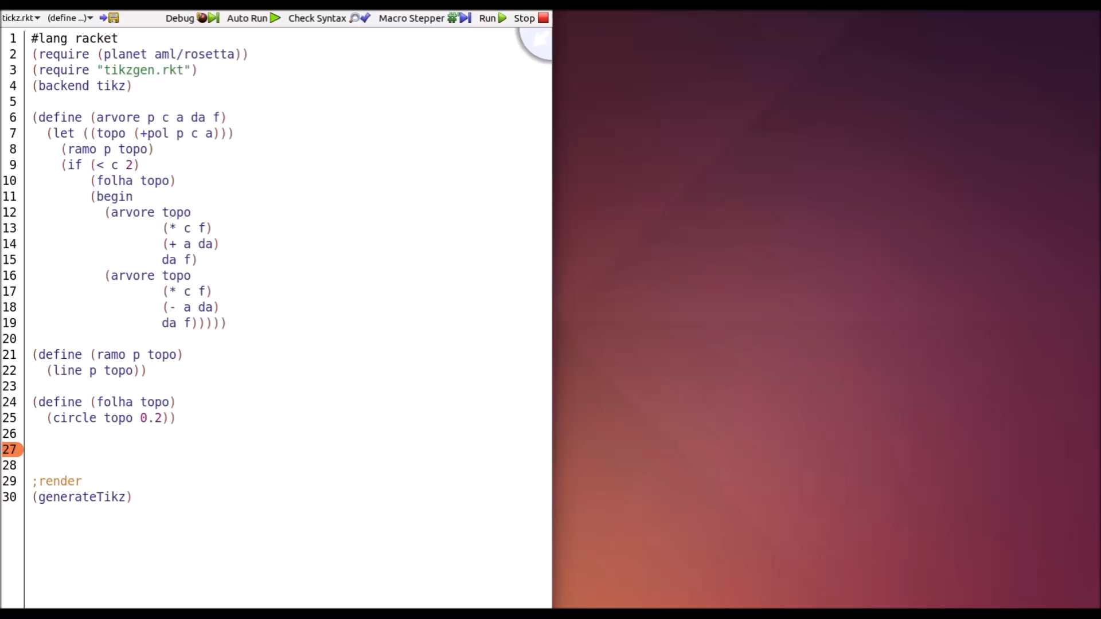

Slide 23
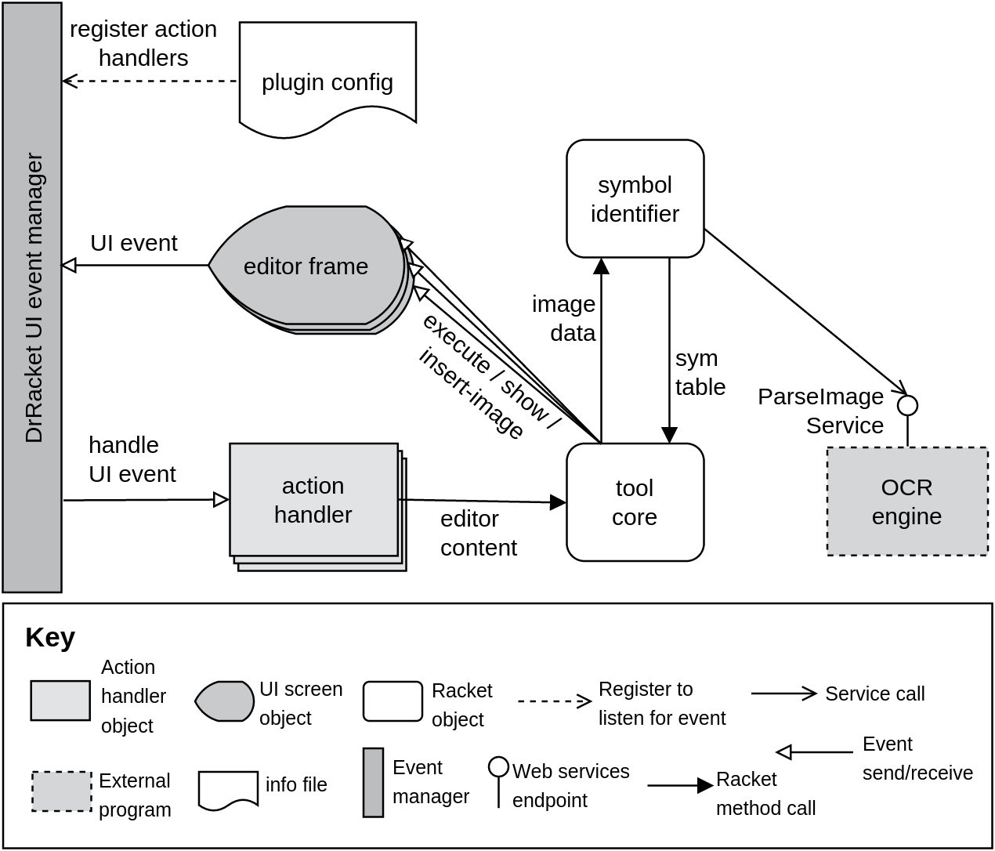

Slide 24
Evaluation
Correctness
Security
Performance
Comparison

Slide 25
4
Conclusion

Slide 26
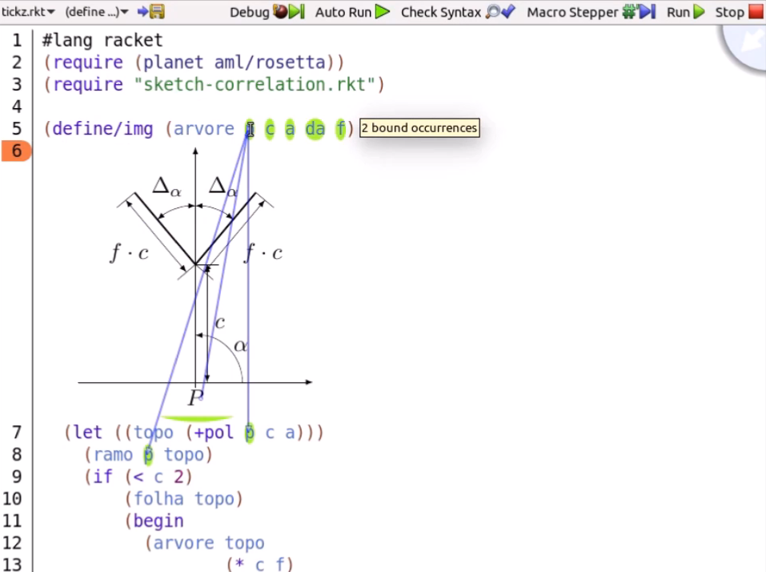
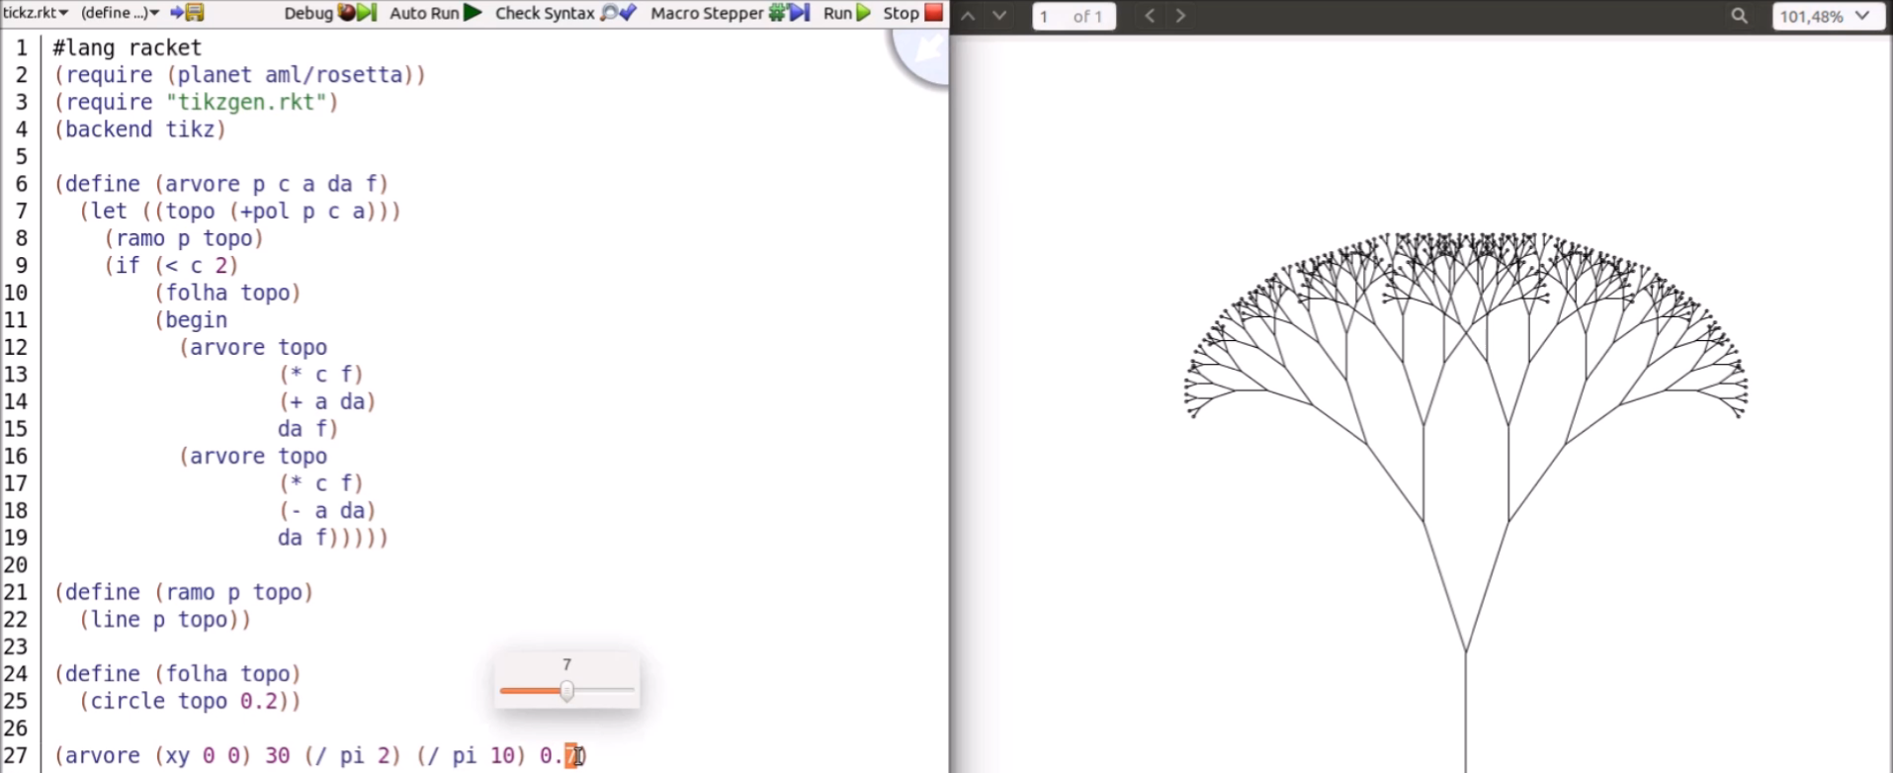
-- Reduces the effort to read the code
-- GD is a particular case
-- Requires an OCR Engine
-- Needs a support for image editing
-- Playground
-- Performance
-- Entire code execution

